Slide 1



What is On-Page SEO?
On-page SEO refers to the optimization of individual web pages to rank higher and earn more relevant traffic in search engines. It involves optimizing both the content and the HTML source code of a page.
Click Here to view more https://wings-rd.000webhostapp.com/
by Sreekrishnan MS

Slide 2

Importance of On-Page SEO
1
Visibility
2
User Experience
On-page SEO enhances the visibility of web pages in search results, leading to increased organic traffic.
It contributes to a better user experience, which is crucial for retaining website visitors.
3
Ranking Factors
Search engines consider on-page SEO as a critical ranking factor for web pages.

Slide 3
Keyword Research and Optimization
Research
Optimization
Understanding user search behavior and intent is crucial for effective keyword research.
Strategically placing keywords within content while maintaining natural readability is key.

Slide 4

Title Tags and Meta Descriptions
1
Title Tags
2
Meta Descriptions
Crafting unique, descriptive, and relevant title tags helps search engines and users understand the content.
Compelling meta descriptions can improve click-through rates by providing a preview of the content.

Slide 5
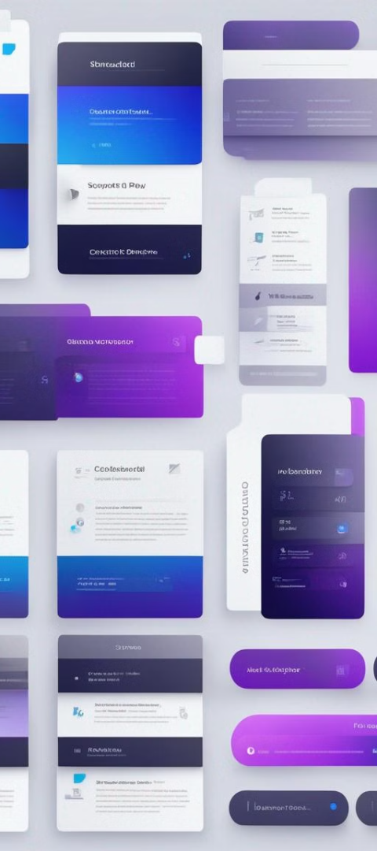
Heading Tags and Content Optimization
1
Structured Content
Using heading tags organizes content and provides a clearer structure for both users and search engines.
2
Content Optimization
Optimizing content with relevant keywords and valuable information enhances its searchability and user relevance.

Slide 6


URL Structure and Internal Linking
Internal Links
Tree Structure
Creating a logical and user-friendly URL structure improves navigation and encourages longer website visits.
Implementing a hierarchical URL structure enhances the organization and accessibility of web pages.

Slide 7
Image Optimization
Compression
Alt Text
Optimizing image file sizes without compromising quality can improve page loading speed.
Descriptive alt text enhances accessibility and provides context for search engines to understand images.

Slide 8
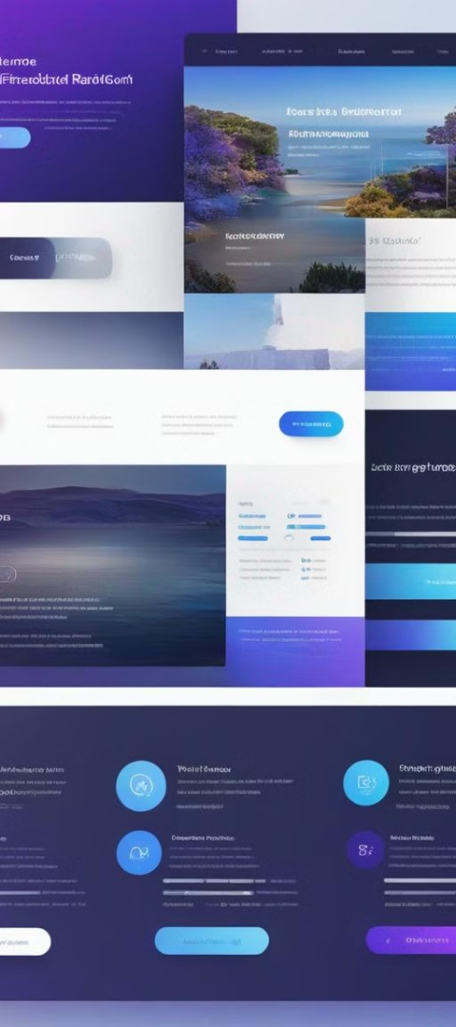
User Experience and Mobile Optimization
Responsive Design
Page Speed
Ensuring websites are mobile-friendly contributes to a seamless user experience across devices.
Improving loading speed on mobile devices positively impacts user engagement and conversions.

Slide 9

Robot Tags
1
Noindex
2
Nofollow
Using noindex tags instruct search engines not to index specific pages, preventing duplicate content issues.
Nofollow tags control the flow of link juice and direct search engines to ignore specified links.

